Slide 1

FIFA 19 player Dataset
Machine Learning Models

Slide 2





18,297 Observations 89 Features 76,984 null values
Data

Slide 3
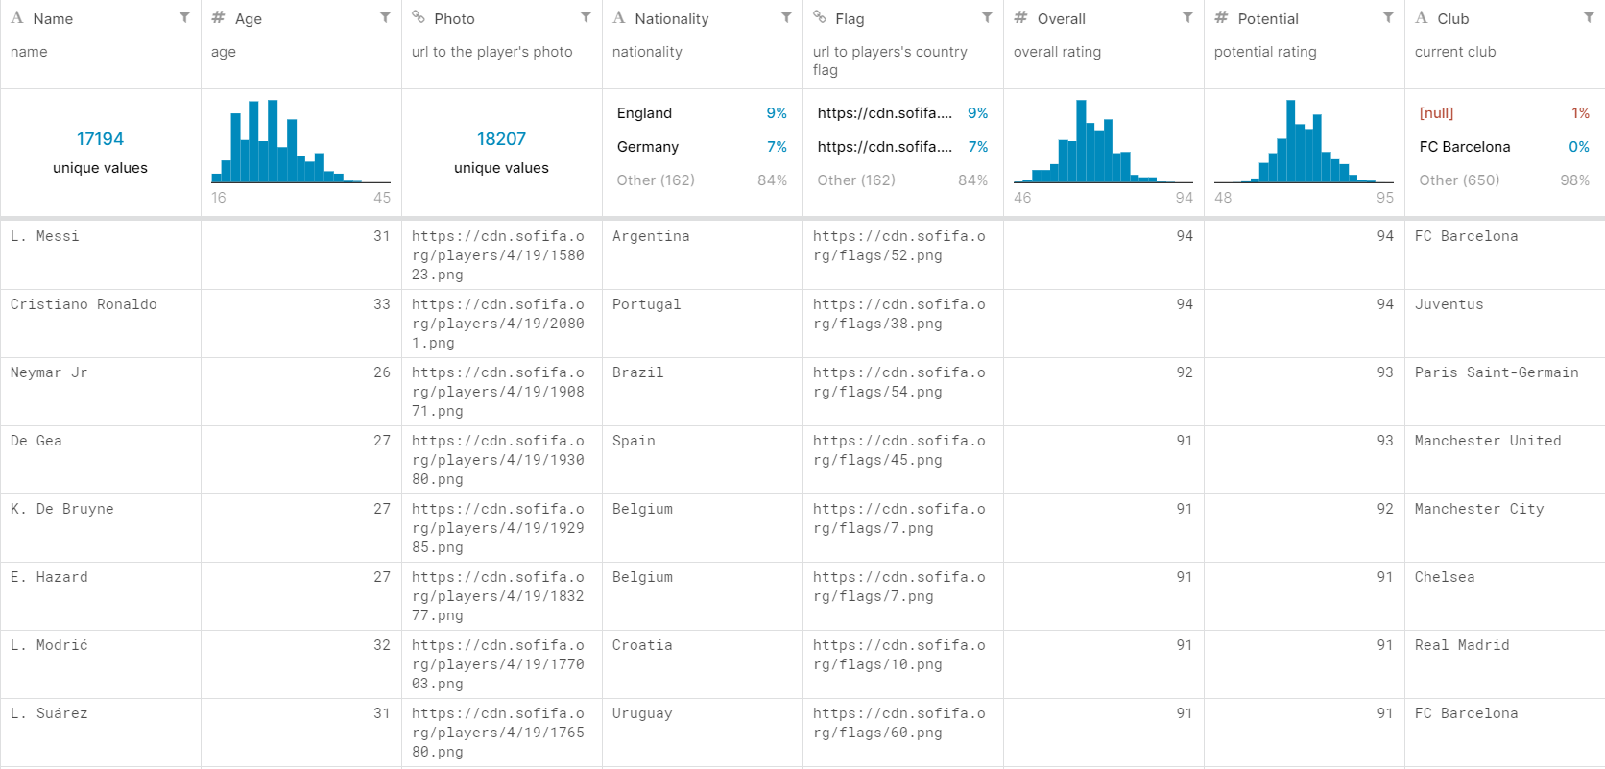
Data

Slide 4

Predict the Overall rating

Slide 5
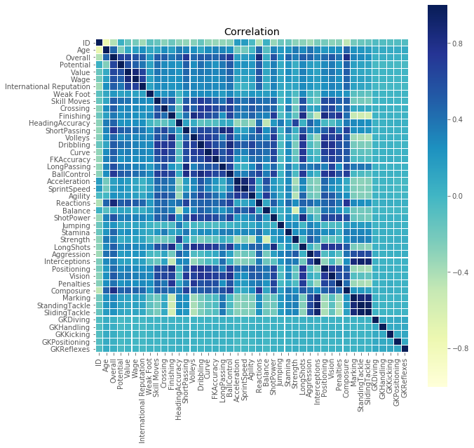
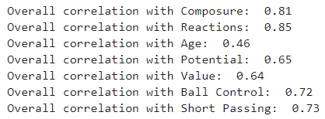
Correlation

Slide 6

Simple Linear Regression

Slide 7
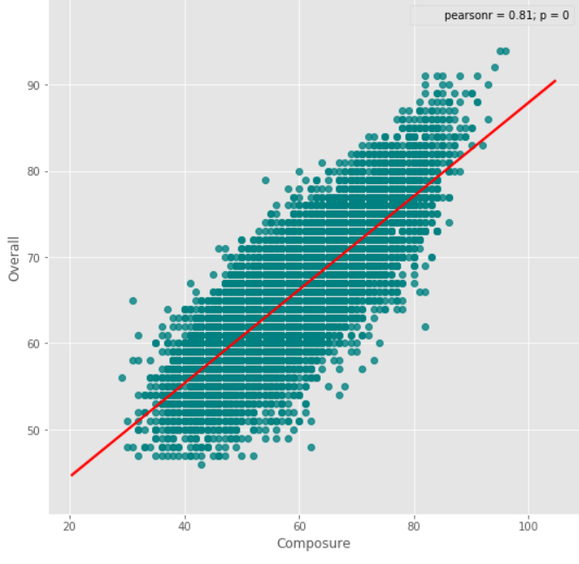
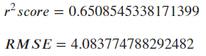
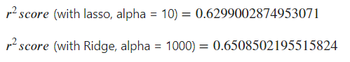
Overall vs Composure

Slide 8
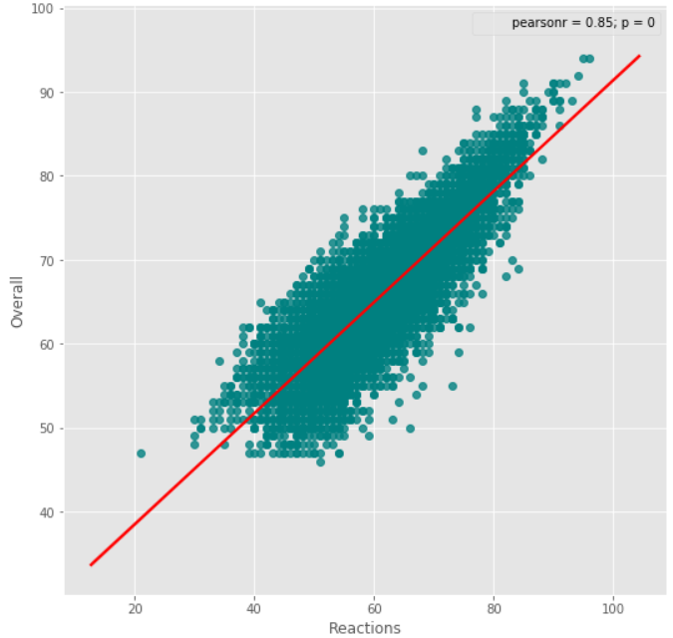
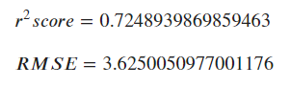
Overall vs Reaction

Slide 9
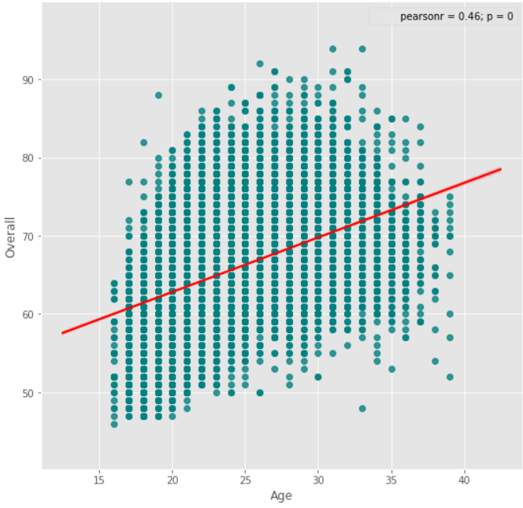
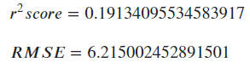
Overall vs Age

Slide 10

Polynomial Regression

Slide 11
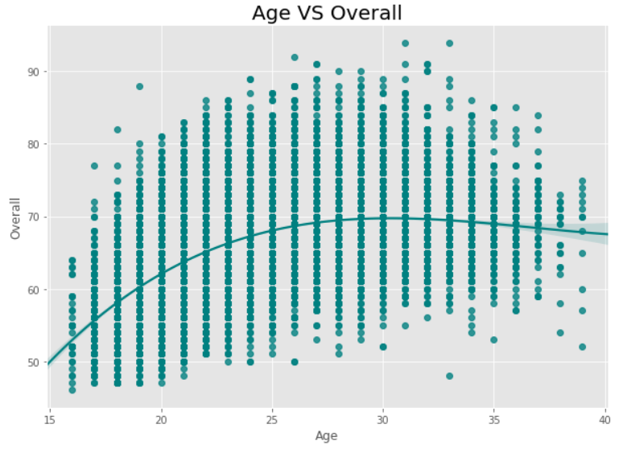
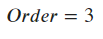
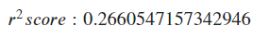
Overall vs Age

Slide 12

Multiple Linear Regression

Slide 13
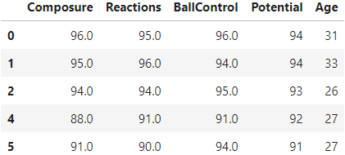
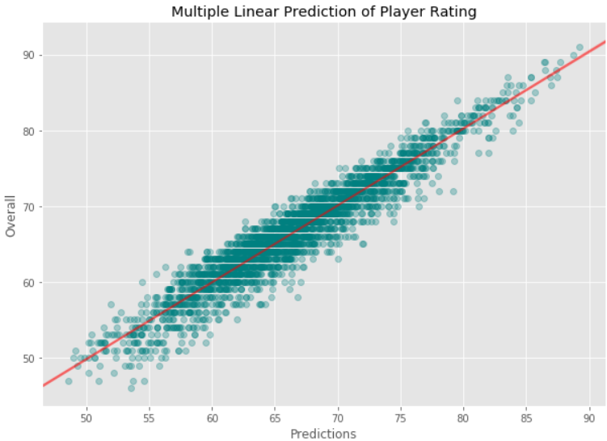
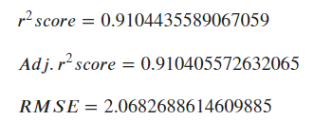
Multiple Linear Regression

Slide 14

Conclusions & Recommendations
Composure, Reactions, Ball Control, Potential and Age
Penalty Functions only when needed
Club < Potential & Age
Potential is the most influent feature
Multiple linear regression

Slide 15

Thanks!

